Slide 1

APEX INSTITUTE OF TECHNOLOGY
DEPARTMENT OF COMPUTER SCIENCE & ENGINEERING
Agile Practices (22CSH-292)
Faculty: Mamta Sharma(E15565)
Lecture 3.1: UX design Development
DISCOVER . LEARN . EMPOWER

Slide 2
Learning Outcome of this lecture
CO1 | Understand the Agile Methodology and comparing various other software development models with agile.
CO2 | Examine Scrum and test driven development
CO3 | Apply the various tools available to agile teams to facilitate the project
CO4 | Analyze the method to improve results for a specific circumstance
CO5 | Evaluate likely successes and formulate plans to manage likely risks or problems

Slide 3
Learning Outcome of this lecture
Unit | Name | Outcome
I | Understanding common Agile Practices in DevOps | Introduction to Product Management, Product Design and Requirement gathering, Product Design Challenges, UX Design, Product Development Methodologies, Product Marketing and Presentation, Traditional Software Development Methodologies, Problem/issues with traditional approach, Agile Development, Agile Manifesto, Scrum Model, Agile Estimations and Planning, Soft skills in agile
CO 1 Apply the Agile Methodology and comparing various other software development models with agile
T

Slide 4
Course Outcomes
CO No. | Statement | Level of Learning (Highest BT Level)
CO1 | Explain how IBM Design Thinking works and using loop Model to understand present and envision future | 1
CO2 | Crafting hill and choose sponsored user, introduction to various methodologies, Agile Methodology and its Frameworks | 2
CO3 | Understanding DevOps, use of DevOps Tools | 3

Slide 5
Outline
The Keys aligns
Hills
Crafting Hill

Slide 6
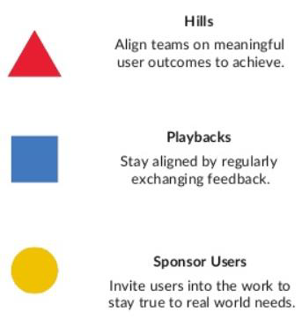
Key align us
“Lead teams to great
user outcomes using our
scalable framework for
team alignment.”

Slide 7
Key align us
With IBM Design Thinking, we have added three scaling practices to the conventional design thinking approach.
They are
• Hills
• Playbacks
• Sponsor Users

Slide 8
Key align us
In practice, complex problems often call for complex teams—and complex teams can be a challenge to manage. Project management frameworks can help manage complexity. We might divide teams into “squads” or “workstreams,” or we might divide time into “sprints” or “phases” We might even standardize around a common process for teams to follow.
No matter how we organize a team, delivering great user outcomes requires us to stay focused and aligned on what matters to users.
The Keys are our three most important techniques for diverse teams to reflect together as we move from idea to outcome. They help us get aligned, stay aligned, and stay in touch with real-world needs—even when we’re deep in the work.

Slide 9
Three Hills, one Foundation
You can do anything, but you can’t do everything.
Hills should reflect an investment in the most valuable outcomes for your users, and the most important differentiators for your organization.

Slide 10
Three Hills, one Foundation
Hills reflect an investment in the most valuable outcomes for your users, and the most important differentiators for your organization.
Hills ensure that your "wow" isn't lost in extraneous features. To focus on a manageable set of goals, make sure that your project has no more than three Hills at any given time.
In addition to your three Hills, define a Foundation. Your Foundation describes key technical and architectural elements that support your Hills. The Foundation also ensures that you are prepared to handle defects and plan for future changes based on in market findings.

Slide 11
Get In Sync
Here’s the truth: on complex projects, things don’t always go as planned. A never-ending stream of feature requests and technical roadblocks threaten to derail progress, delay releases, and throw even the healthiest teams out of alignment.
Despite these uncertainties, how can a team stay true to a project’s intent?
Hills communicate our intent for a project with clarity and flexibility. They frame problems as intended user outcomes, not predetermined implementations, empowering teams to discover breakthrough solutions. They help us keep the eye on the prize, even despite the many challenges that stand in our way. If you're getting started writing Hills, they don't have to be perfect. Hills should evolve with your understanding of the problem. Hold playbacks early and often. Your Hills will most likely change, so make sure that the full team is aware of the updates.

Slide 12
Crafting a Hill
Who
Who are your users? Make it clear who you aim to serve—and who you don’t.
What
What’s the need they’re trying to meet? Turn user needs into project goals.
Wow
How will you differentiate from competitors? How will you measure success?

Slide 13
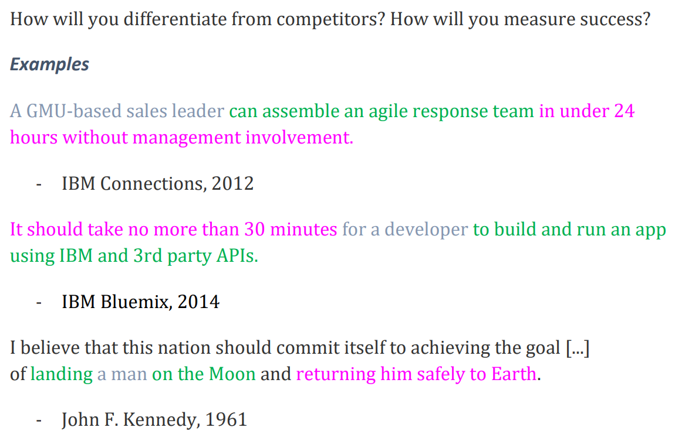
Crafting a Hill

Slide 14
Text Books and Reference Books
T1 Agile Project Management with Kanban - Book by Eric Brechner
T2 Agile Foundations: Principles, Practices and Frameworks – Peter Measey
Reference Books:
1 Agile Project Management with Kanban Eric Brechner 2nd Microsoft Press 2021
2 Agile Foundations Peter Measey(4th BCS,) The Chartered Institute for IT 2015

Slide 15
References
https://www.mygreatlearning.com/blog/importance-of-design-thinking/
https://www.interaction-design.org/literature/article/5-stages-in-the-design-thinking-process
https://en.wikipedia.org/wiki/Design_thinking

Slide 16
THANK YOU
For queries
Email: mamta .e15565@cumail.in

